Slide 1






HACKATHON

Slide 2
ACES TECHFEST 7.0!
HACKATHON | 2024
Team: Autoencoder
B.S.c.CSIT 6th Sem Godawari College
Date: 2024/12/13

Slide 3
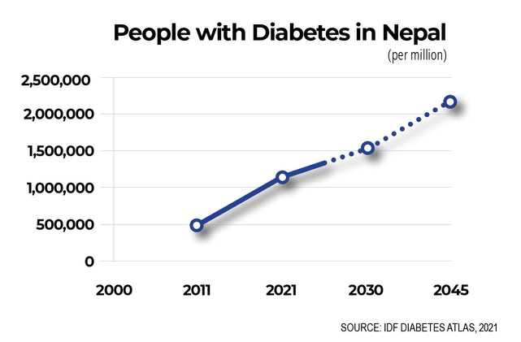
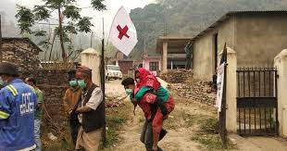
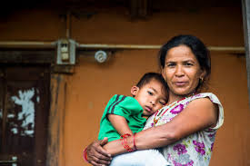
The Challenge in Nepal's Healthcare
Limited accessibility to early diagnosis and preventive healthcare.
Difficulty in understanding medical reports for general people
There is a need for technology to bridge gaps in healthcare.
Geographic Health Disparities and Awareness

Slide 4





Mero Health
Offers Diagnosis of Cancer and Diabetes using ML Classifier Model.
Provide FAQs, a Light Aptitude Test, a Live Chat System, and a Community
Information on hospitals in major cities of Nepal
Simple Health Report Analysis with Speech
Integrated ChatBot

Slide 5


Future Advancements
Generalized ML/Deep Learning Prediction Models
Capacity of Analyzing Complex Medical Reports
Personal AI Health Assistant (NLP)
Digitalizing the Health Sector

Slide 6
THANK YOU

Slide 7
PROJECT DEMO TIME
MeroHealth

